Slide 1
Can Wins Fill The Seats?
The study of the relationship between wins and average home attendance in the NBA
Alex Yom

Slide 2
Overview
Introduction
Dataset
Analysis
Discussion
Future Work

Slide 3
Introduction
NBA team owners want to generate as much revenue as possible.
Fans would be more motivated to watch their hometown teams and spend their money to watch games if their hometown teams win games.
Could there be a relationship between the amount of games a team wins and the team’s average home attendance throughout a season?
My initial hypothesis was that wins would not have a significant impact on average home attendance.

Slide 4
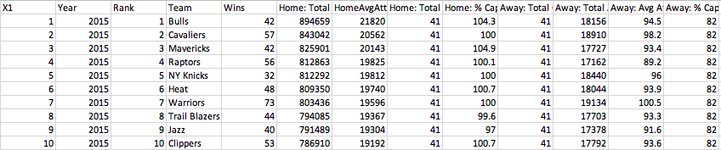
Dataset
The dataset used for this research consisted of a ranking of each team in the NBA ranked in terms of their average home attendance for the season with the number one ranked team being the team with the highest average attendance for the season. A column representing the total games each respective team won during the season was included. The data spanned from the 2000-2001 season to the 2015-2016 season.

Slide 5
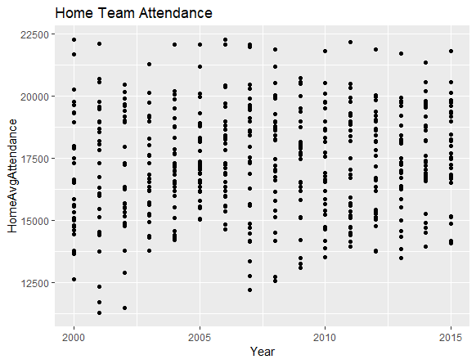
Analysis
Introductory analysis of average home attendance league-wide seem to be trending upwards.
The floor for the lowest average home attendance throughout the league appears to increase as the years go by indicating the growing popularity of the NBA

Slide 6
Examining Average Home Attendance Deviation From League Average
The following graphs show diverted bar plots showing the team that averaged the highest average home attendance first and then going down the ranking list and also shows how above or below the league average attendance each team performed
The greatest difference in average home attendance came in the 2001-2002 season with the difference being 10,821 people on average between the first ranked San Antonio Spurs and the last ranked New Orleans Pelicans.
The 2014-2015 season showed the smallest difference of 7,302 people on average between the first ranked Chicago Bulls and the last ranked Philadelphia 76ers.
An interesting trend to note from these graphs is that the same teams seem to dominate the upper echelon while the same teams find themselves on the bottom year after year.

Slide 7
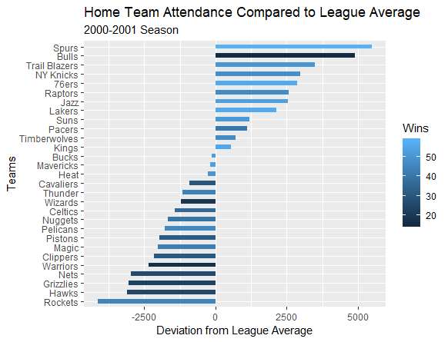
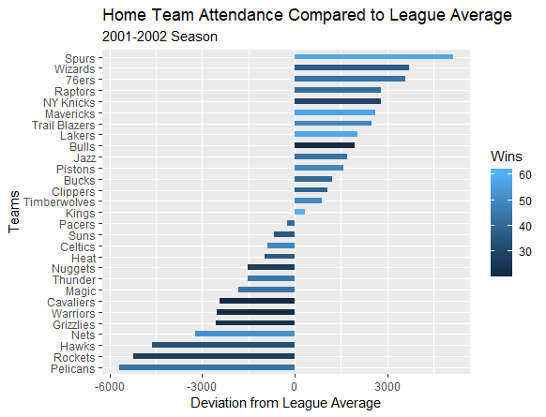
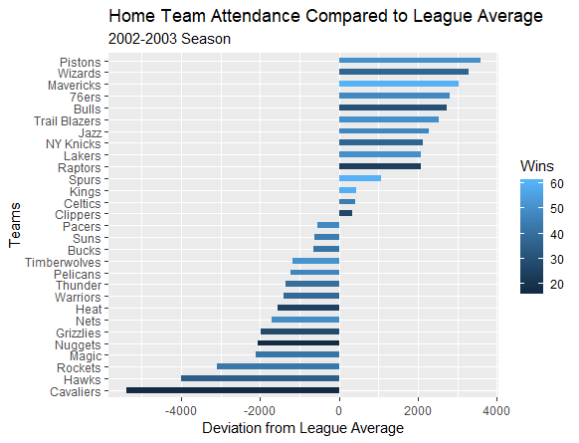
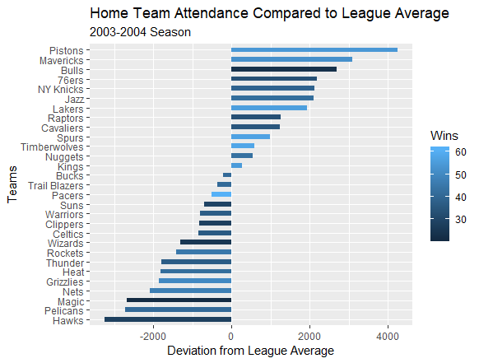
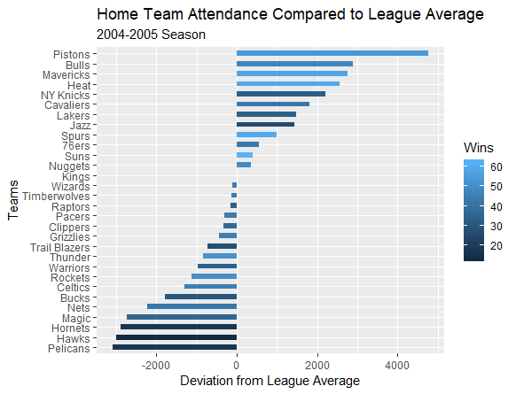
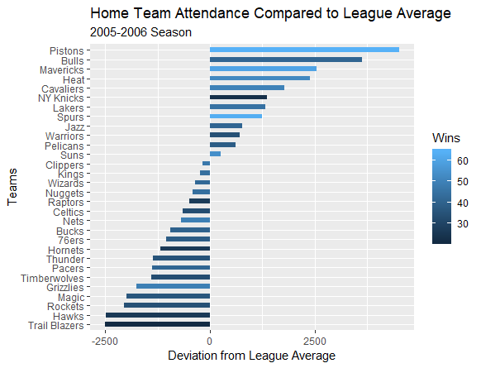

Slide 8
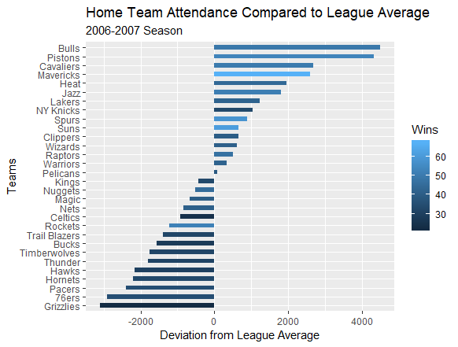
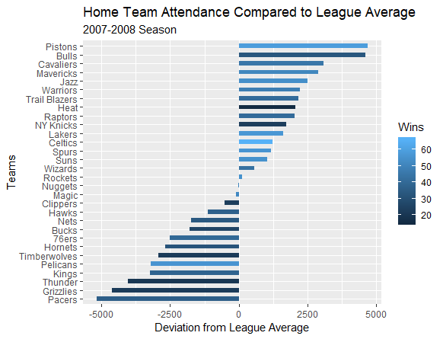
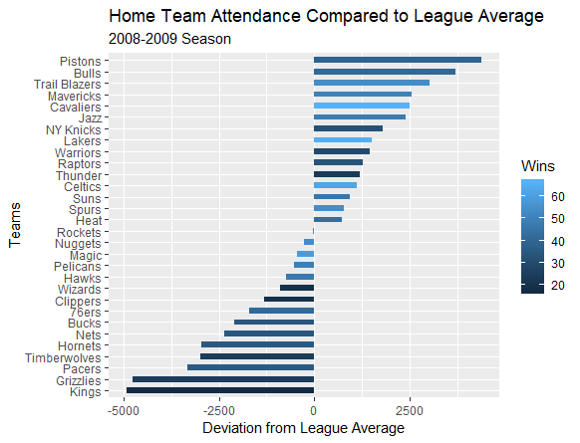
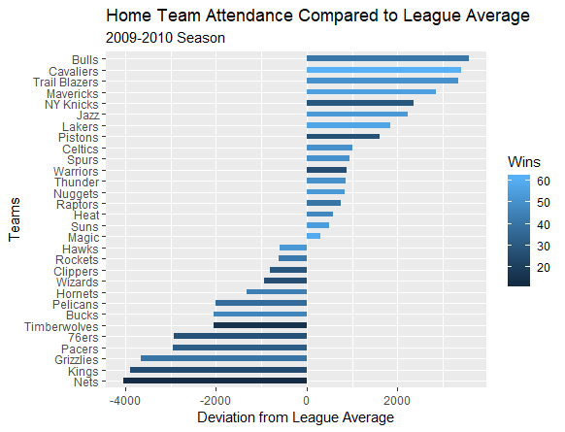
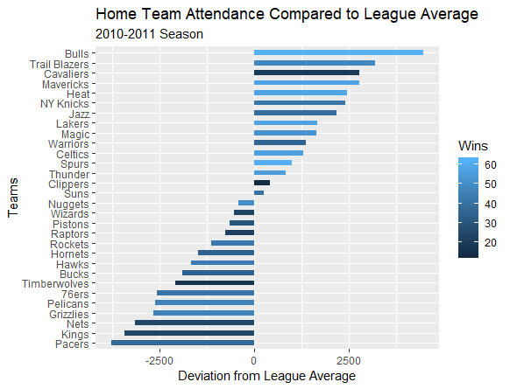
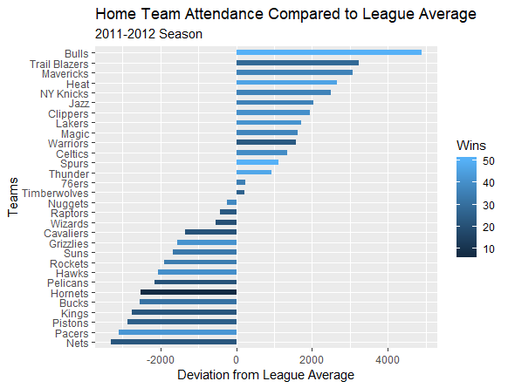

Slide 9
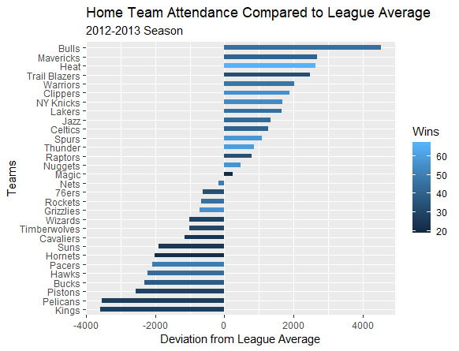
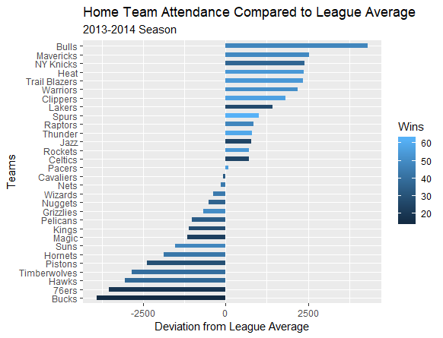
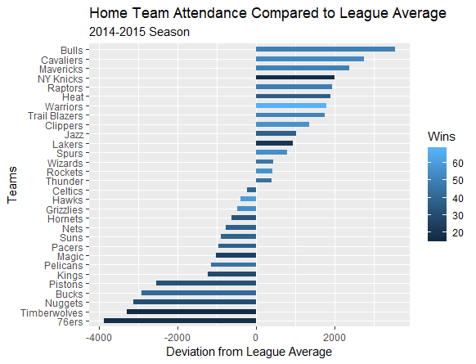
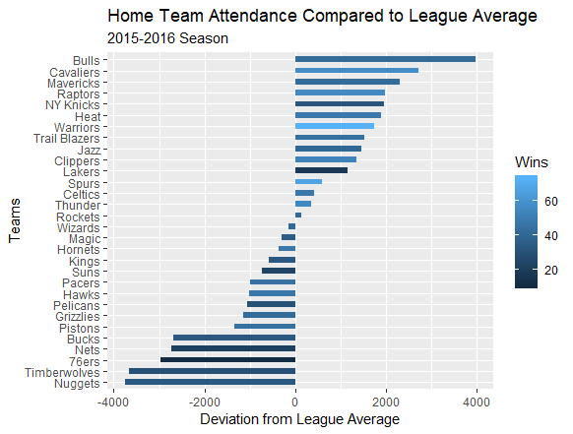

Slide 10
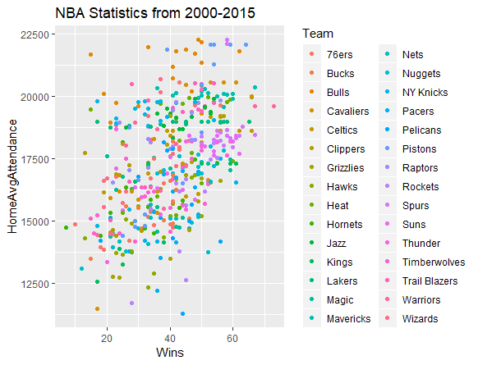
League Wide Overview of Wins and Attendance
Trend between wins and average home attendance for all teams through the 2000-2001 season to the 2015-2016 season
The correlation is .47

Slide 11
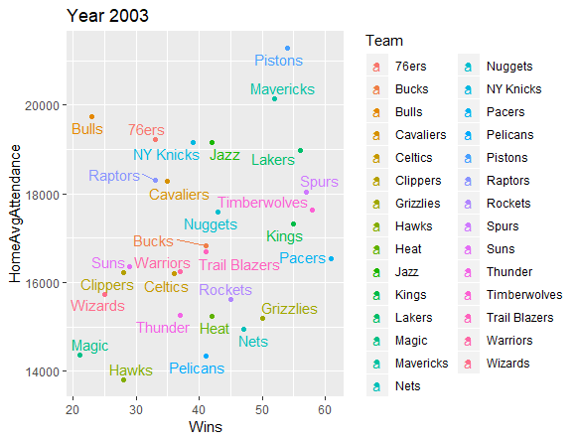
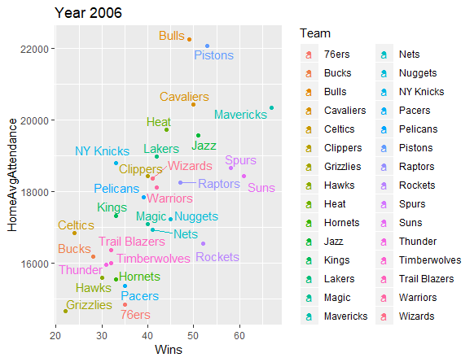
The 2003-2004 season showed the smallest correlation of all the other seasons with a correlation of .28
The 2006-2007 season showed the biggest correlation with a correlation of .69

Slide 12
Analysis of Each Team in the NBA
We looked into each year and found that although there was a wide spectrum of correlations throughout the years, there does seem to be a correlation between wins and average home attendance. Would that same relationship apply when looking at each specific team as well?
Most teams in the league showed fairly strong correlations and very few teams showed even negative relationships
Teams with the highest correlations
Detroit Pistons: .83
Denver Nuggets: .80
Memphis Grizzlies: .77
Teams with the lowest correlations
Dallas Mavericks: -.06
New York Knicks: -.02
New Orleans Pelicans: .01

Slide 13
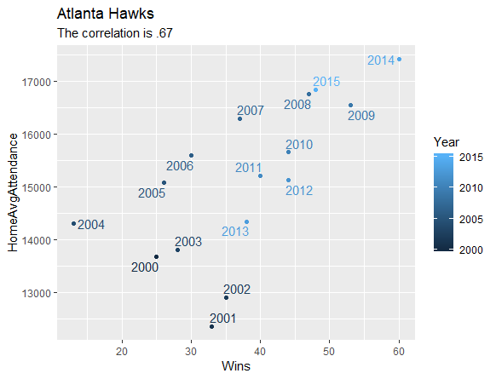
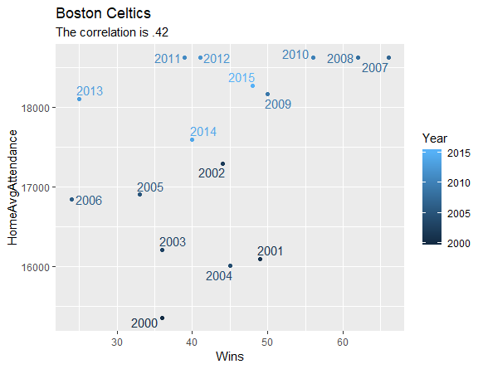
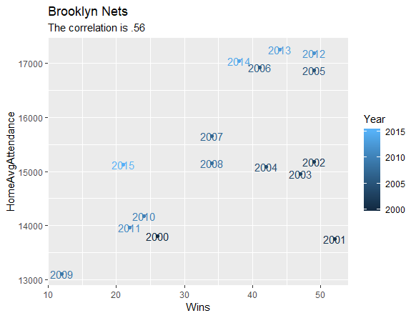
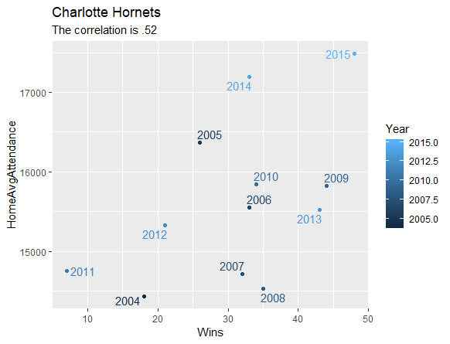
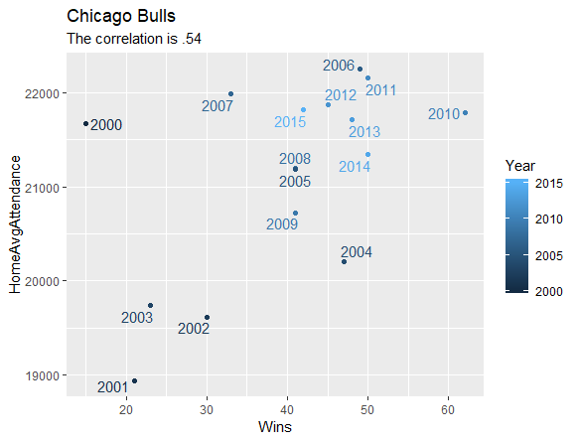
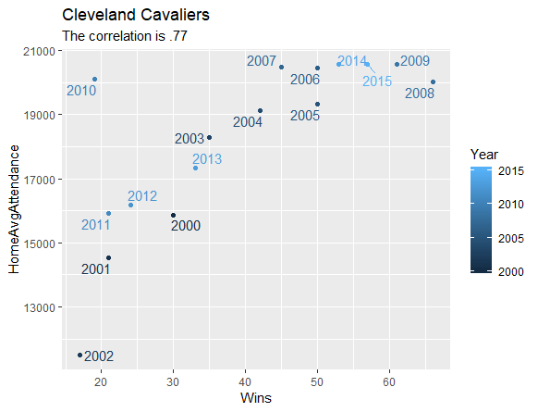

Slide 14
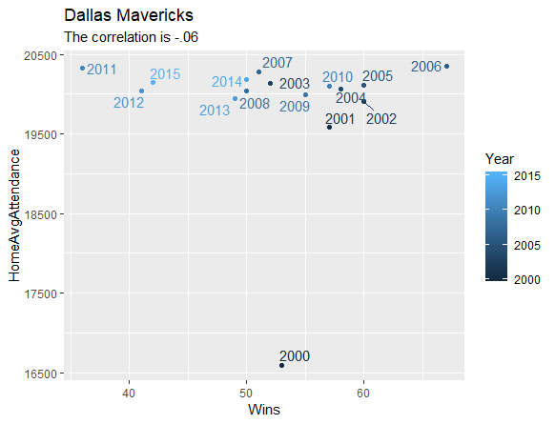
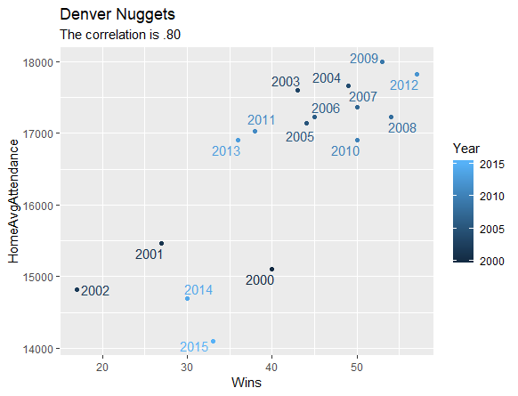
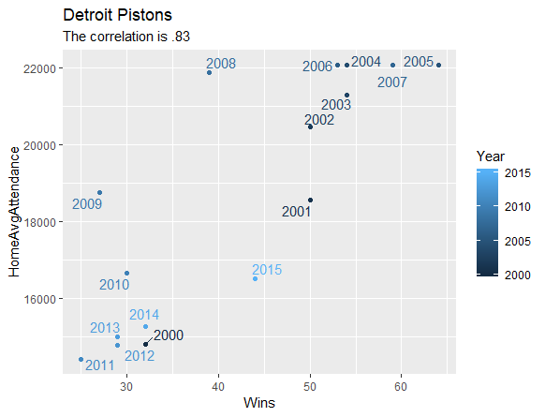
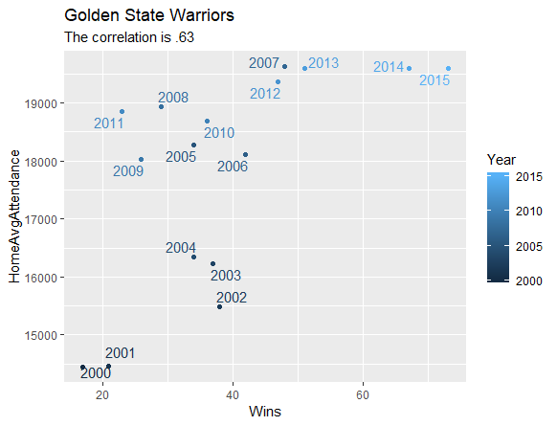
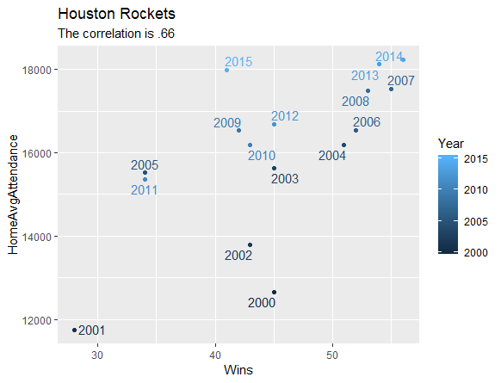
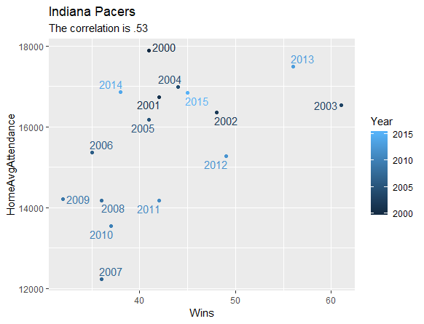

Slide 15
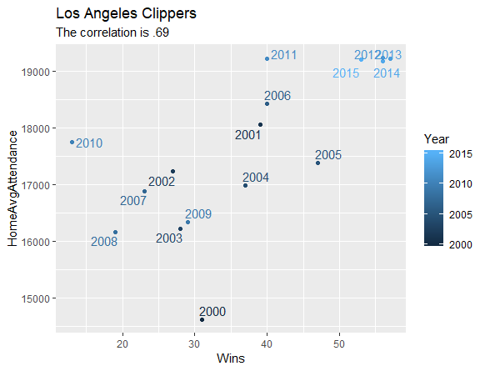
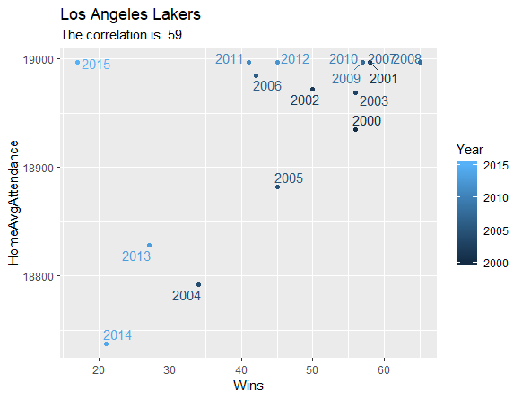
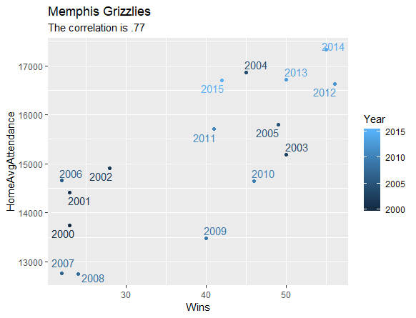
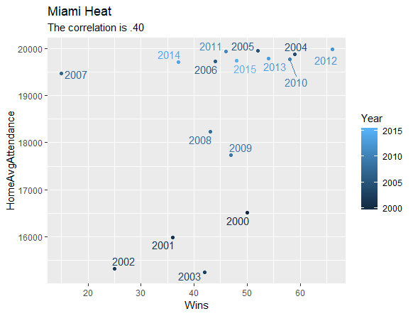
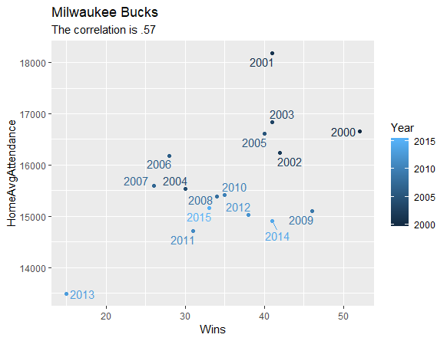
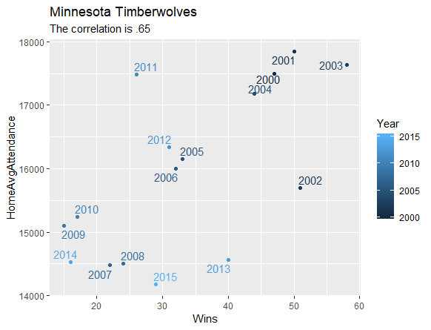

Slide 16
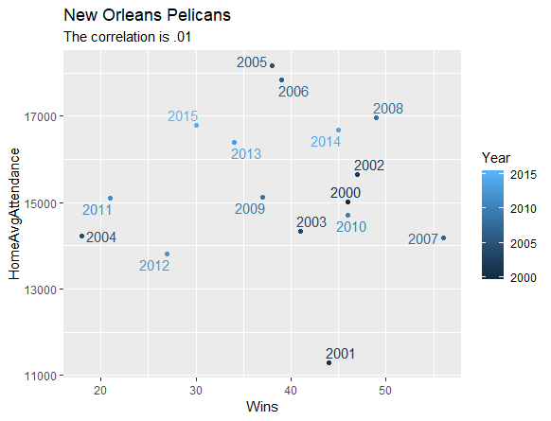
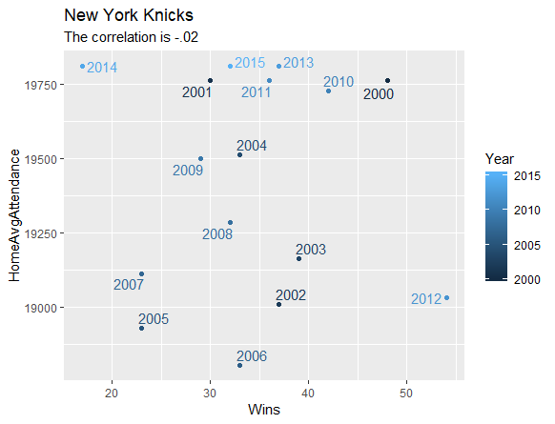
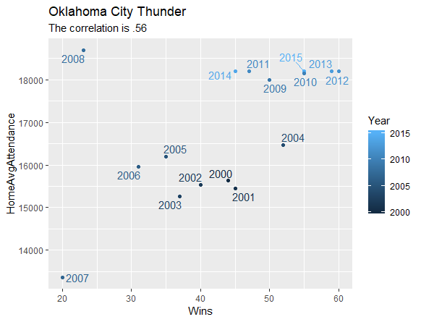
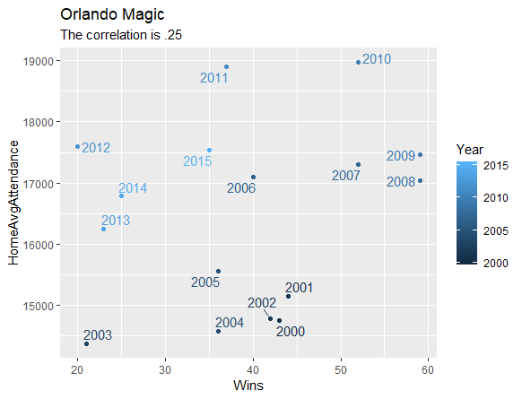
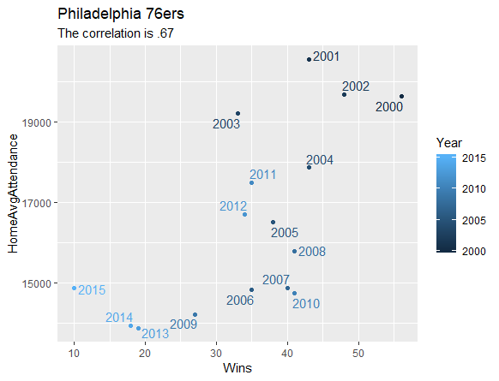
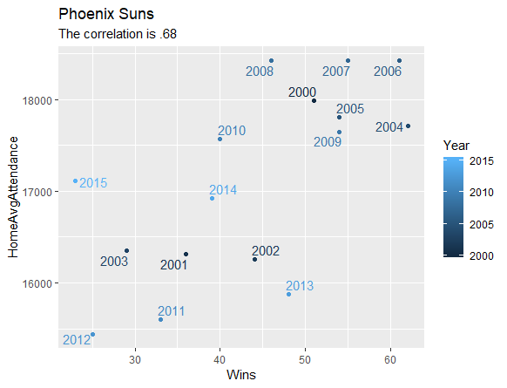

Slide 17
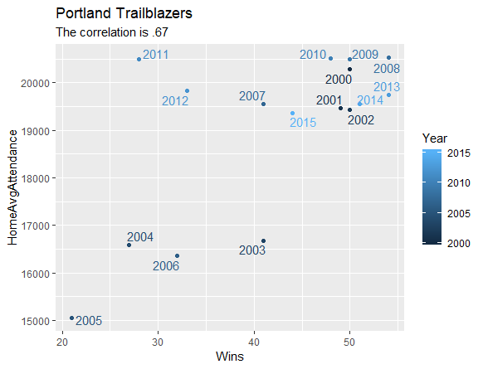
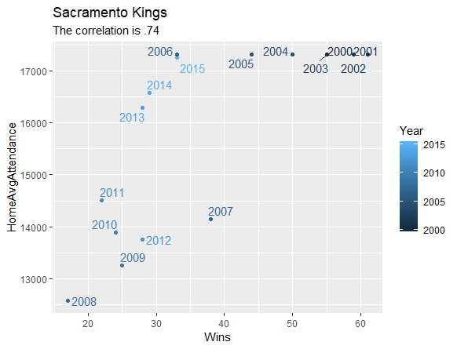
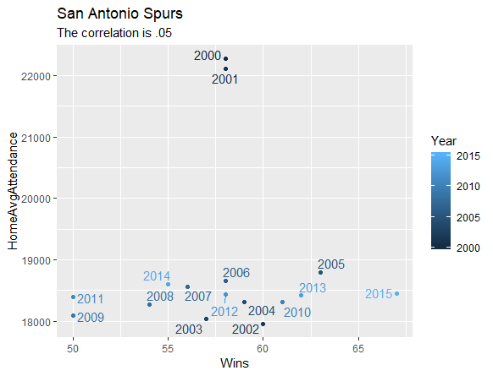
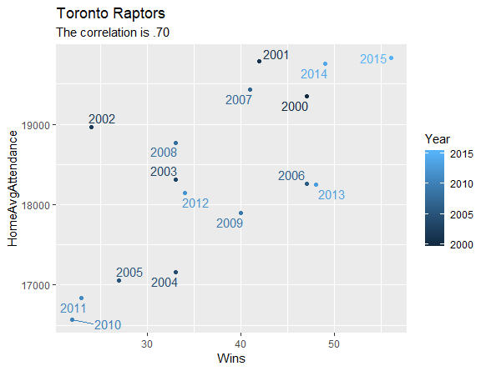
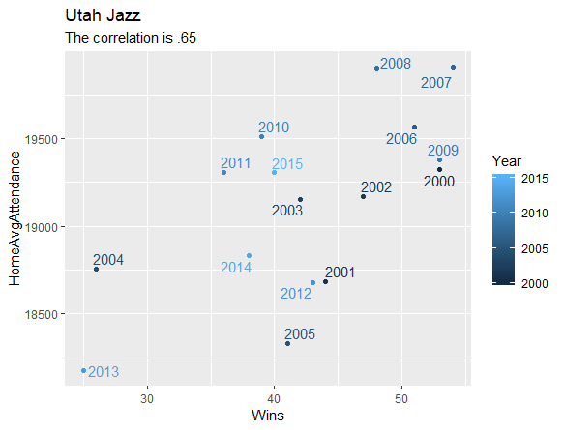


Slide 18
Discussion/Application
Contrary to my initial hypothesis, the analysis seem to depict a correlation between wins and average home attendance.
To locate specific team trends, it would be more useful to look at the scatterplots for the specific team as the correlations vary greatly per team.
Although the Detroit Pistons have been struggling in attracting a large home attendance as of recent seasons, an individual within the Detroit Pistons organization could potentially look at the data and see the high correlation and attempt to increase attendance by constructing a team that is able to win more games. (The Pistons were among the league leaders in average home attendance when they were winning many games during the early 2000’s)
The New York Knicks posted a negative correlation and are able to maintain their stronghold in the upper echelon of popular turnout despite not winning many games. This may be explained by their luxury of playing in a huge economic market.

Slide 19
Discussion/Application
Could there be another way to increase attendance?
Starting from the 2011-2012 season, the Los Angeles Clippers experienced average home attendance never seen before. Coincidentally, that season was the first season of their extremely popular team nicknamed, “Lob City”
The Washington Wizards exhibited substantially high attendance during the 2001-2002 and 2002-2003 seasons. These seasons were the two seasons that saw one of the NBA’s more iconic players, Michael Jordan, suit up for the Wizards.

Slide 20
Future Considerations
By using the percentage of seats filled as a variable instead of just raw average home attendance could be a way of putting every team on a level playing field as some teams play in bigger stadiums which would account for a higher average attendance.
Further explore the impact that a popular player or group of players can have on attendance

